Slide 1



Solution Design Report - Conclusion
Pavel Bansky
Senior SharePoint Consultant
Litware Inc

Slide 2
Agenda
Assessment summary
Solutions that will be redesigned
Detailed approach per solution
Support for the app transformation
Roles and involved people
Responsibilities on both sides

Slide 3
Assessment summary

Slide 4
Summary on findings
Majority of the existing solutions in the farm can be transformed into the Office 365 platform
Will be replaced with out of the box capabilities or combined to existing solutions
Required solutions can be implemented with known capabilities with in the app model
No known gaps based on reported business requirements

Slide 5
Contoso solutions
C – Complexity
E – Effort to move
Legend
Solution | C | E
contoso.sharepoint.safetynews.wsp
contoso.sharepoint.branding.wsp
contoso.sharepoint.provisioning.wsp
contoso.sharepoint.docretention.wsp
contoso.sharepoint.libraryreceivers.wsp
contoso.sharepoint.newsalerts.wsp
- Transform
- Abandon
- Unclear
- Easy to do
- Average
- Hard one
Notes:
News alerts feature will be abandoned since Yammer can fulfil Contoso’s requirements natively.

Slide 6
Third Party solutions
C – Complexity
E – Effort to move
Legend
- Transform
- Abandon
Solution | C | E
wingtip.migrationhelper.wsp
adventureworks.analytics.wsp
fabricam.locationfinder.wsp
tailspin.skillfinder.wsp
- Unclear
- Easy to do
- Average
- Hard one
Notes:
Migration helper solution cannot be transformed. Contoso needs to evaluate other third party offerings that make use of SharePoint web service to migrate data.

Slide 7
App Maturity Level
Currently not used by Contoso
Customer Preparedness
1
Branding
0
Remote provisioning
0
Composites and bus apps
0
Governance
0
Readiness from infrastructure and process perspective to move to app model?
Hosting environment decision done with needed testing towards the SP farm
Hosting environment available
Deployment process in place for SharePoint apps
Branding model impact to customizations?
Non-FTC deployment of branding
No custom master page (theme and JS injection)
Documented process and guidance for projects on how to deal with branding
Remote provisioning model existence and maturity level?
Site collections created using remove process
Assets (+content types) deployed during provisioning
Sub site creation managed via the provisioning solution
Maturity of the composite and business app structures?
Agreed patterns for cloud and on-premises app connectivity
Tested and verified models with reference implementation
Infrastructure and process existence for composite and business apps.
How do we control customizations in SharePoint?
Existence of generic guidance and architecture principals for app model.
ALM process documented and available
Standardized model to design and control customizations: consistency between solutions
Notes:
The numbers on the slide signify the “App Maturity Level” in the scale of (0-3)
0 – For solutions that cannot be moved into the App model
From the kick-off meeting we have gathered that Contoso is prepared to transform the solutions to Office 365 friendly model.
Contoso is using full trust solutions for Branding, Provisioning. These cannot be moved to the Office 365 model as is. These solutions will have to be transformed using the proven App model techniques.

Slide 8
Solution transformation
What will be now actually done for the Office 365 to enable app model based solutions…

Slide 9
Solution Summary
Many of the solutions can be transformed to the new App model using proven techniques
(Branding, Location Finder, Staff Finder)
Only limited set of solutions have been abandoned because they can be implemented using CSOM techniques
(Analytics, News Alerts)
No known CAM blockers based on the analyses
All known requirements can be implemented using the known APIs in the Office 365
Solutions for app model | S
Contoso Branding
Fabrikam Location Finder
Tailspin Skill Finder
Contoso Records Management
Safety News
News Alerts
Contoso Provisioning Framework
Contoso Event Handlers
Analytics
Notes:
The colours on the right indicate the simplicity with regards to the transformation process.

Slide 10

Safety News Rollups contoso.sharepoint.safetynews.wsp
Branding
Complexity:
Medium
Owner: Contoso
High level requirements:
Display safety news on the landing page.
Should display safety incidents irrespective of department
Provide a mobile friendly view of the safety news item when accessed from mobile devices.
Ability to like and share the news article will be a good to have.
Design and Notes
Safety news will be created as announcements within Yammer.
The Yammer embedded code will replace the custom safety news web part on the homepage. The Yammer integration can also provide “sharing” and “like” options natively.
Yammer mobile app will render mobile views natively.
Notes:
The team responsible for transforming the solution has been identified in the “Owner” section.

Slide 11
Branding
Branding
Complexity:
Medium
Owner: Contoso
High level requirements:
Typical Intranet features:
Custom page layouts
A branded site theme.
Social features (commenting, tag cloud)
Site Navigation
UI elements
Share price, world clock, weather, emergency information, image rotator
Other intranet features:
Site provisioning for collaborative sites
MySite customizations
Notes:
The team responsible for transforming the solution has been identified in the “Owner” section.

Slide 12
Branding
Branding
Complexity:
Medium
Owner: Contoso
Design and Notes
Branding on the master page will be achieved through the use of alternate CSS.
SP Color tool will be used to create the “spcolor” file which can then be referenced in the Theme.
Replace web parts with following approaches
Content by query and content by search OOB web parts
JS based reading and updating of data
Provider hosted apps with app parts
Avoid using custom master page for collaboration sites
Use CSS and JS to achieve the desired look and feel
Replace (delegate) controls with JS based implementations
Replace Content Query web parts with content search web parts.
Dashboards on the homepage will be designed using out of the box lists with JS Link.
Notes:
The team responsible for transforming the solution has been identified in the “Owner” section.

Slide 13
Provisioning
Provisioning
Complexity:
Medium
Owner: Contoso
High level requirements:
To be able to:
Prevent custom user actions
Prevent the users from using certain site templates
Allow users to create sub sites through electronic requests
Implement security around the sites so that they are visible only to the requestor
Allow auto activation of some site features during site provision
My Sites should be set to expire after one year
Design and Notes:
UI required for the end users to select the type of the site template
Actual provisioning of the site collection will be done using CSOM. You can use CSOM or REST for additional configurations
Notes:
The team responsible for transforming the solution has been identified in the “Owner” section.

Slide 14
Records Management
Records Management
Complexity:
Medium
Owner: Contoso
High level requirements:
Typical Intranet features:
Send notification emails when policies are due for revision.
Delete records that are more than 5 years old.
Log action taken on expired documents
Design and Notes
Business logic could be factored to one or more oData Web Services
Scheduled Web Job will be hosted on Azure
A trusted service account may be required because there would be no concept of “Elevated Privileges” in the external hosting environment.
Notes:
The team responsible for transforming the solution has been identified in the “Owner” section.

Slide 15
Records Management
Records Management
Complexity:
Medium
Owner: Contoso
High level requirements:
Typical Intranet features:
Send notification emails when policies are due for revision.
Delete records that are more than 5 years old.
Log action taken on expired documents
Design and Notes
Business logic could be factored to one or more oData Web Services
Scheduled Web Job will be hosted on Azure
A trusted service account may be required because there would be no concept of “Elevated Privileges” in the external hosting environment.
Notes:
The team responsible for transforming the solution has been identified in the “Owner” section.

Slide 16
Event handlers contoso.sharepoint.eventreceivers.wsp
Event Receivers
Complexity:
Medium
Owner: Contoso
High level requirements
List Event Receivers to capture list metadata
Web creation and deletion events as per business rules
Site columns and content type creation on feature activation
Migration
Remote event receivers can be used that can be invoked through a provider hosted app.
Challenges
None
Notes:
The team responsible for transforming the solution has been identified in the “Owner” section.

Slide 17
News notifications contoso.sharepoint.newsalerts.wsp
News Notifications
Complexity:
Easy
Owner: Contoso
High level requirements:
Typical Intranet features:
To be able to inform users about a major safety incident instantly
Migration
The solution will be abandoned. Yammer sends automated emails when an announcement is added.
Challenges
None
Notes:
The team responsible for transforming the solution has been identified in the “Owner” section.

Slide 18
Skill Finder
Skill Finder
Complexity:
Medium
Owner: Contoso
High level requirements:
Allow users to search experts on the basis of their years of experience and past projects.
Allow the users to be able to communicate with the experts using a tool.
Design notes and status
The solution will be replaced using the SharePoint People search
The People search will provide integration with Lync which can then be used to communicate with the expert using messaging or voice call.
TailSpin
Notes:
The team responsible for transforming the solution has been identified in the “Owner” section.

Slide 19

Location Finder
Location Finder
Complexity:
Easy
Owner: Litware
High level requirements:
Should allow users to search for Fabrikam outlets
Should map the locations on interactive Bing Map
Migration:
Use search display templates to return search results.
Design notes and status
SharePoint search and display templates will be used to achieve the end goal.
Notes:
The team responsible for transforming the solution has been identified in the “Owner” section.

Slide 20
Web Analytics
Analytics
Complexity:
Easy
Owner: Litware
High level requirements:
Discover keywords, phrases and the most clicked-on results.
Provide the session history of all SharePoint users.
Provide information on popular content
Design notes and status
Contoso will make use of SharePoint 2013 usage Reports.
Client side techniques will be used to inject JS using script blocks on master page.
Challenges
None
AdventureWorks
Notes:
The team responsible for transforming the solution has been identified in the “Owner” section.

Slide 21
Contoso Office 365 logical architecture
Skill finder
Location Finder
Analytics
Contoso services
Contoso Branding
Contoso Framework
Provisioning
Timer Jobs
Branding
Development
Transformation

Slide 22
Framework
Framework = Agreed way to implement needed capabilities to align used models to product and service roadmap

Slide 23
Development focus areas
Provisioning framework
Remote timer framework
Branding and asset framework
Development framework
Transformation framework
Currently features are spread across multiple solutions.
Should just be one provisioning engine which takes care of the all required customizations.
Remove usage of feature framework elements and deploy assets using remote provisioning.
Timer jobs should be replaced by Azure Web jobs.
Updates to the existing functionalities to match app model techniques.
Branding topics.
Example: Use JavaScript for header and footer capability in the Branding solution to avoid need of custom master page
What goes to SP, what goes to CDN?
Chosen hosting platform impacts the detailed design of the capabilities for Office 365 apps directly. Framework needs to support both cloud and on-prem.
General design and guidance for the provider hosted app implementation missing. Typical topics are logging and caching techniques.
General design on removing FTC solutions.
Transformation tooling, like updating existing master pages or transforming custom list templates to new app model format.
Notes:
CDN – Content Delivery Network

Slide 24
Key considerations
Key decisions we agreed during the engagement

Slide 25
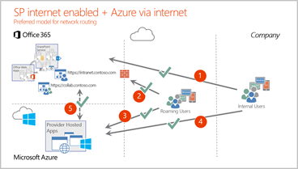
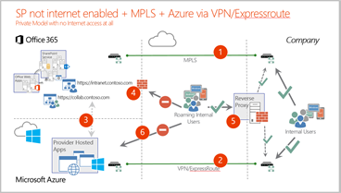
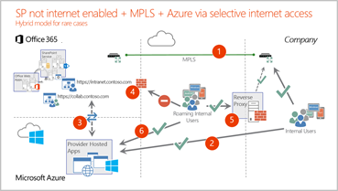
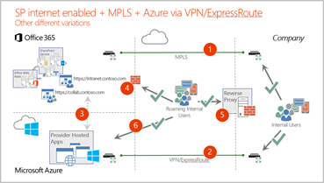
Network design and access
Overall network design will have significant impact on the different opportunities and implementation details

Slide 26
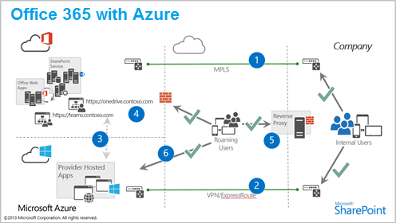
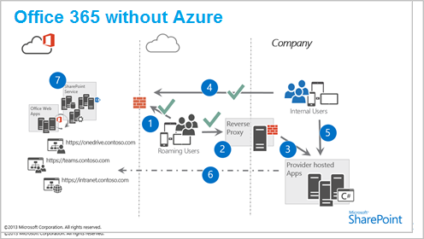
Hosting platform for Office 365
Office 365 has been designed to be used with Azure, so that should be the default approach
Other solutions are also supported, but make the environment much more complex

Slide 27
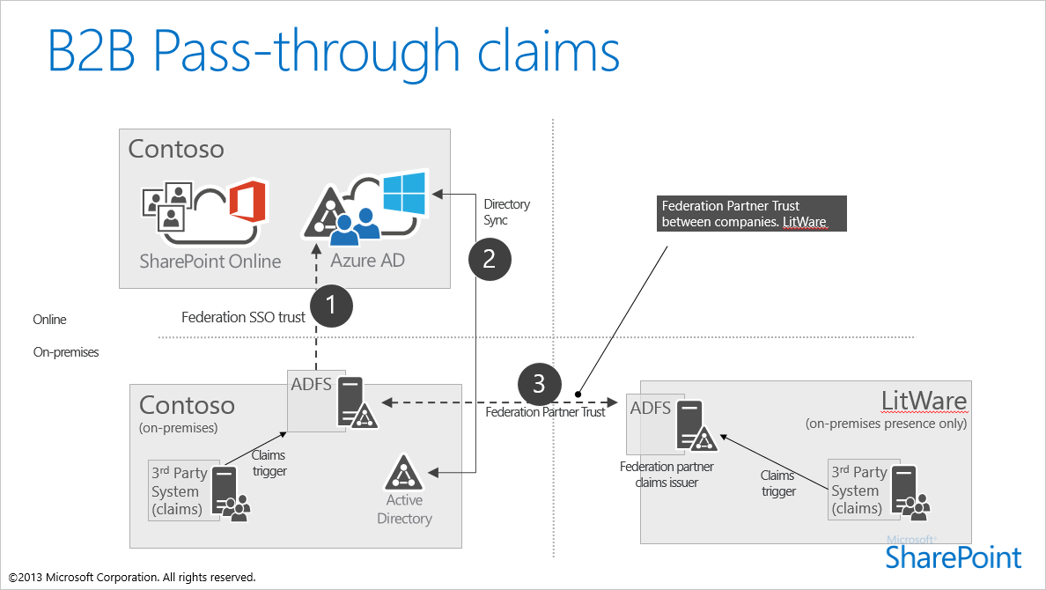
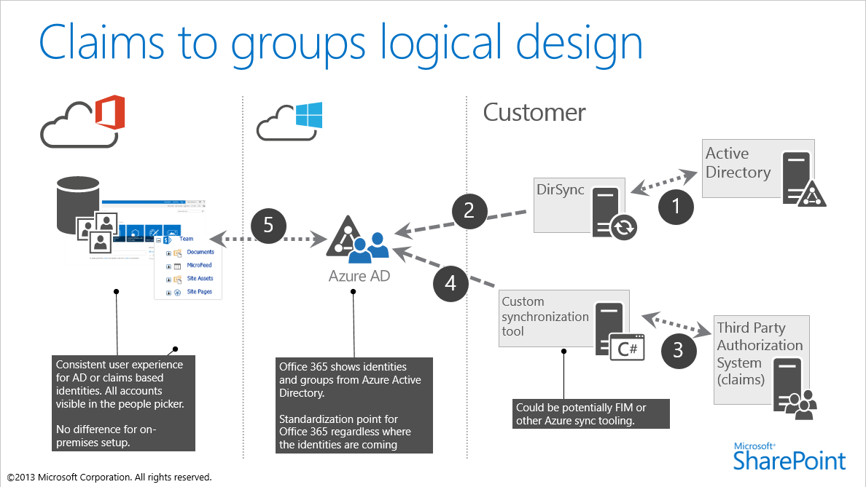
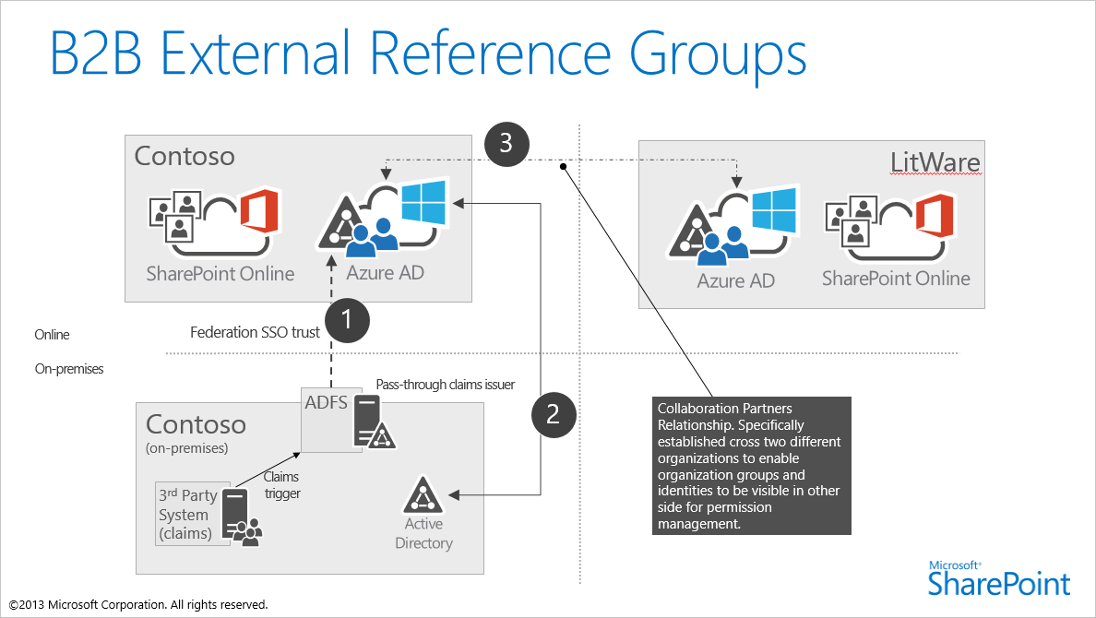
SAML and external access
External access for partners is planned to be enabled with out of the box capabilities
Additional information captured in the notes from the workshop held on 24th Jan 2015.

Slide 28
PnP Transformation assistance

Slide 29
Application Modernization PnP Transformation Approach
Customer Preparedness
Solution Assessment
Architecture Session
STEP 1
Empower & Plan
App hosting configuration. Leverage available resources to ramp up dev resources
Analyze solution inventory / requirements and provide guidance on solution modernization
Provide architecture design guidance for selected scenarios
Deliverable:
Successful smoke test app to validate configuration
Deliverable:
Assessment report
Deliverable:
Architecture Design Report
Development SOW (optional)
Development & Testing
Deployment
STEP 2
Develop & Deploy
Provide funding to off-set costs associated with development and testing
Retract FTC
Deploy App solutions
Deliverable:
Tested solution artifacts
Deployment Guide
Deliverable:
Replace FTC by APP
Project signoff

Slide 30
Develop & Deploy
Development & Testing
Results in a Deployment Guide and solution artifacts.
Engagement Criteria | Roles & Responsibilities |  | Deliverable
 | Contoso | Litware
Requirement document Architecture Design document Completed readiness checklist Approved Statement of Work | Project management | Consultation by Litware SMEs Development by Litware resource + SME consultation | Tested solution artifacts Deployment Guide
Development
Developers
Module Overview
Kickoff
Development support
Technical input
Reference samples
Technical discussions
Testing support
Next Steps
Testing and documentation
Getting started
Stage
Everybody
Testers
Everybody
Audience

Slide 31
Develop & Deploy
Deployment
Support for deployment of modern SharePoint applications. Provide guidance for deployment of new modern applications and to retract FTC. Results in FTC applications replaced by App Model applications.
Engagement Criteria | Roles & Responsibilities |  | Deliverable
 | Contoso | Litware
Application solution design details Deployment Guide | Project Management Customer Developer Resource | Consultation by Litware SMEs Deployment by Litware resource + SME consultation SPO-D operational support Troubleshooting and support | Replace FTC by APP applications Project signoff
Everybody
PPE testing
Module Overview
Kickoff
Kickoff
Initial acceptance deployment
Initial acceptance deployment
Customer acceptance testing sign-off
Customer acceptance testing sign-off
Production deployment
Production deployment
Final verification
Kickoff
Initial acceptance deployment
Customer acceptance testing sign-off
Production deployment
Final verification
Final verification
FTC retraction
FTC retraction
Next Steps
Next Steps
Production Deployment
Post deployment activities
Stage
Audience

Slide 32
PnP Transformation support for Contoso
Focus on every solution that needs to be converted
Identify the focus areas where Contoso would require help from Litware resources.
Assigned SME to help with the needed actions and to work as a single point of contact for any additional information for the app transformation
Separate weekly meetings with third party providers
PnP transformation focuses on the customization migration
Content migration will be completed by Litware as part of the service transformation actions

Slide 33
Key Contacts
PnP Transformation Program
Pavel Bansky – EMEA lead and SME support for assigned project
Belinda Newman – SME support for assigned projects
Rob Young – Global technical lead
Project Manager
Denis Dehenne –project manager for the Office 365 releated task
Other
Pavel Bansky works as the technical lead for the Office 365 transformation

Slide 34
Other Office 365 related information
Workshops which were agreed during executive briefing session have been started
Compliance Center, Record Management and MMS sync with Contoso was held last week
SAML and external access workshop is scheduled to be held this week
Monthly Meetings
Monthly meetings will be schedules to track progress
Denis Dehenne will drive the meeting based on the inputs from project team

Slide 35

Questions?

Slide 36


© 2014 Microsoft Corporation. All rights reserved. Microsoft, Windows, and other product names are or may be registered trademarks and/or trademarks in the U.S. and/or other countries.
The information herein is for informational purposes only and represents the current view of Microsoft Corporation as of the date of this presentation. Because Microsoft must respond to changing market conditions, it should not be interpreted to be a commitment on the part of Microsoft, and Microsoft cannot guarantee the accuracy of any information provided after the date of this presentation. MICROSOFT MAKES NO WARRANTIES, EXPRESS, IMPLIED OR STATUTORY, AS TO THE INFORMATION IN THIS PRESENTATION.

